Slide 1
How Learning some idioms

Slide 2












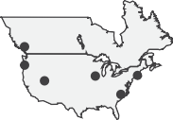

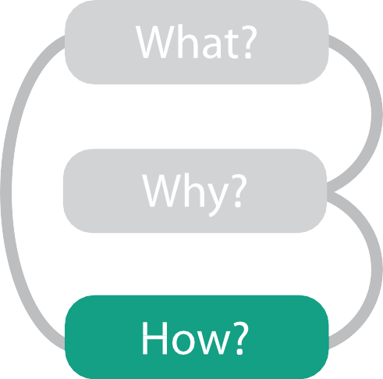


How?
Encode
Manipulate
Facet
Reduce
Arrange
Express
Map
from categorical and ordered attributes
Color
Hue Saturation Luminance
Change
Juxtapose
Filter
Separate
Order
Align
Select
Partition
Aggregate
Size, Angle, Curvature, ...
Use
Navigate
Superimpose
Embed
Shape
Motion
Direction, Rate, Frequency, ...

Slide 3
Encode tables:Arrange space
Encode
Arrange
Express
Separate
Order
Align

Slide 4








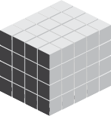

Arrange tables
Express Values
Axis Orientation
Rectilinear
Parallel
Radial
Separate, Order, Align Regions
Separate Order
Layout Density
Dense
Space-Filling
Align
1 Key
List
2 Keys
Matrix
3 Keys
Volume
Many Keys
Recursive Subdivision

Slide 5

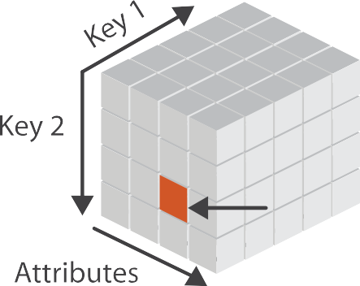




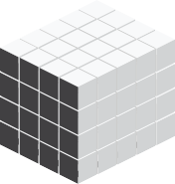

Keys and values
Tables
Attributes (columns)
key
– independent attribute
– used as unique index to look up items
– simple tables: 1 key
– multidimensional tables: multiple keys
value
– dependent attribute, value of cell
classify arrangements by key count
– 0, 1, 2, many...
Items (rows)
Cell containing value
Multidimensional Table
Value in cell
Express Values
1 Key
List
2 Keys
Matrix
3 Keys
Volume
Many Keys
Recursive Subdivision

Slide 6




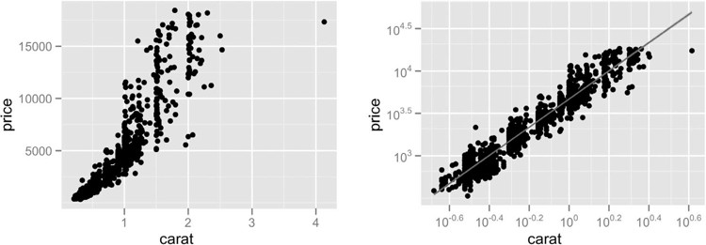
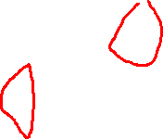
Idiom: scatterplot
Express Values
express values
– quantitative attributes
no keys, only values
– data
2 quant attribs
– mark: points
– channels
horiz + vert position
– tasks
find trends, outliers, distribution, correlation, clusters
– scalability
hundreds of items
[A layered grammar of graphics.Wickham. Journ. Computational and Graphical Statistics 19:1 (2010), 3–28.]
10

Slide 7




Some keys: Categorical regions
Separate Order
Align
regions: contiguous bounded areas distinct from each other
– using space to separate (proximity)
– following expressiveness principle for categorical attributes
use ordered attribute to order and align regions
1 Key
List
2 Keys
Matrix
3 Keys
Volume
Many Keys
Recursive Subdivision

Slide 8








Idiom: bar chart
100
75
50
25
0
100
75
50
25
0
one key, one value
– data
1 categ attrib, 1 quant attrib
– mark: lines
– channels
length to express quant value
spatial regions: one per mark
Animal Type
Animal Type
separated horizontally, aligned vertically
ordered by quant attrib
» by label (alphabetical), by length attrib (data-driven)
– task
compare, lookup values
– scalability
dozens to hundreds of levels for key attrib

Slide 9

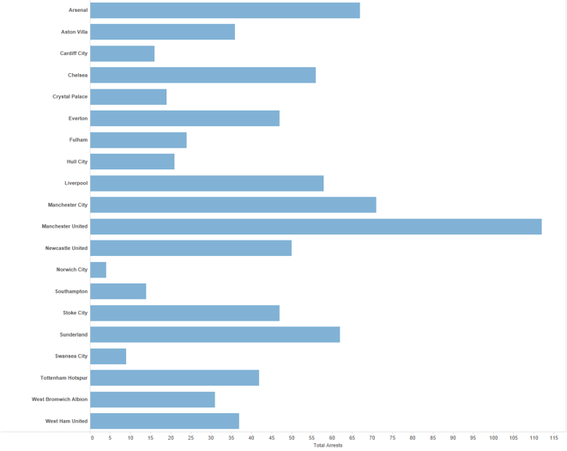
Separated and Aligned but not Ordered
LIMITATION: Hard to know rank. What’s the 4th most? The 7th?
[Slide courtesy of Ben Jones]

Slide 10
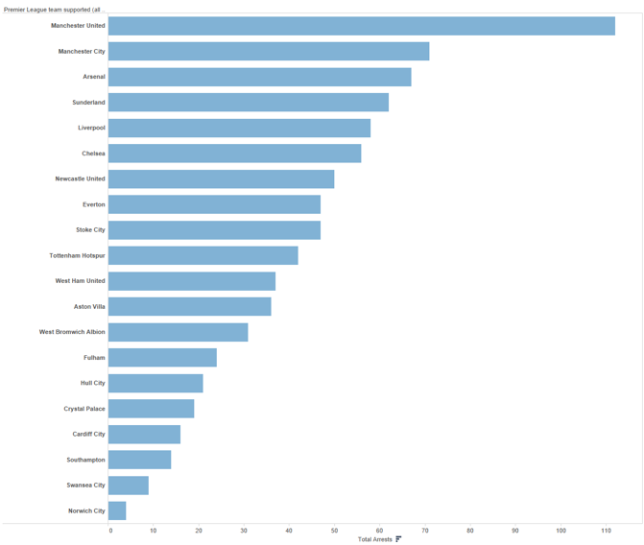
Separated, Aligned and Ordered
[Slide courtesy of Ben Jones]

Slide 11
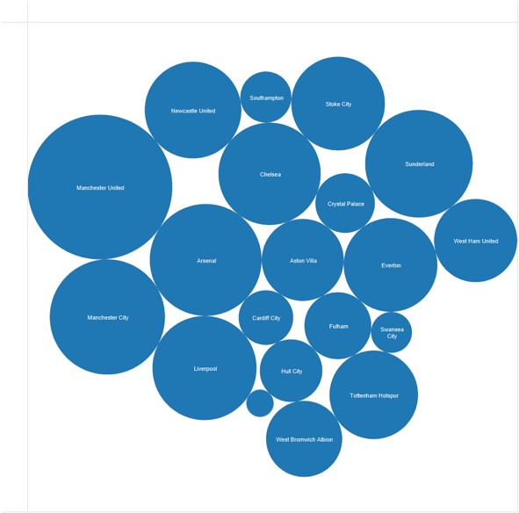
Separated but not Ordered or Aligned
LIMITATION: Hard to make comparisons
[Slide courtesy of Ben Jones]

Slide 12
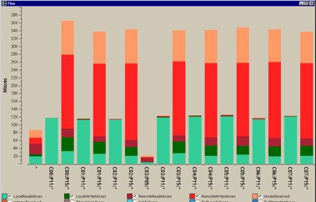
Idiom: stacked bar chart
one more key
– data
2 categ attrib, 1 quant attrib
– mark: vertical stack of line marks
glyph: composite object, internal structure from multiple marks
– channels
[Using Visualization to Understand the
length and color hue
spatial regions: one per glyph
aligned: full glyph, lowest bar component
unaligned: other bar components
– task
part-to-whole relationship
– scalability
several to one dozen levels for stacked attrib
Behavior of Computer Systems. Bosch. Ph.D. thesis, Stanford Computer Science, 2001.]
16

Slide 13
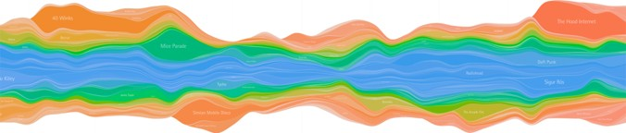
Idiom: streamgraph
generalized stacked graph
– emphasizing horizontal continuit
vs vertical items
– data
1 categ key attrib (artist)
1 ordered key attrib (time)
1 quant value attrib (counts)
– derived data
y
[Stacked Graphs Geometry & Aesthetics. Byron and Wattenberg. IEEE Trans.Visualization and Computer Graphics (Proc. InfoVis 2008) 14(6): 1245–1252, (2008).]
geometry: layers, where height encodes counts
1 quant attrib (layer ordering)
– scalability
hundreds of time keys
dozens to hundreds of artist keys
– more than stacked bars, since most layers don’t extend across whole chart
17

Slide 14



Idiom: line chart / dot plot
20
15
10
5
0
one key, one value
– data
2 quant attribs
– mark: points
line connection marks between them
– channels
aligned lengths to express quant value
Year
separated and ordered by key attrib into horizontal regions
– task
find trend
– connection marks emphasize ordering of items along key axis by explicitly showing relationship between one item and the next
– scalability
hundreds of key levels, hundreds of value levels

Slide 15









Choosing bar vs line charts
60
50
40
30
20
10
0
60
50
40
30
20
10
0
depends on type of key attrib
– bar charts if categorical
– line charts if ordered
do not use line charts for categorical key attribs
– violates expressiveness principle
implication of trend so strong that it overrides semantics!
– “The more male a person is, the taller he/she is”
Female
Male
Female
Male
60
50
40
30
20
10
0
60
50
40
30
20
10
0
10-year-olds 12-year-olds
10-year-olds 12-year-olds
after [Bars and Lines: A Study of Graphic Communication. Zacks and Tversky. Memory and Cognition 27:6 (1999), 1073–1079.]

Slide 16
https://youtu.be/GjouT1ihpCE?t=62
https://youtu.be/iGlLLzw5_KM?t=7

Slide 17
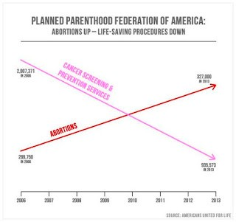
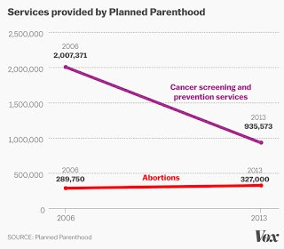
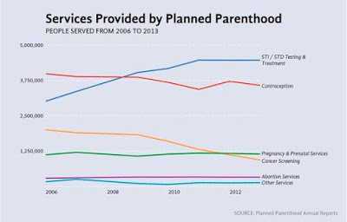
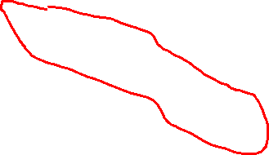
Chart axes
labelled axis is critical
avoid cropping y-axis
include 0 at bottom left
or slope misleads
dual axes controversial
acceptable if commensurate
beware, very easy to mislead!
http://www.thefunctionalart.com/2015/10/if-you-see-bullshit-say-bullshit.html
20

Slide 18
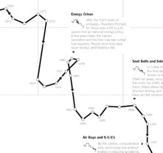
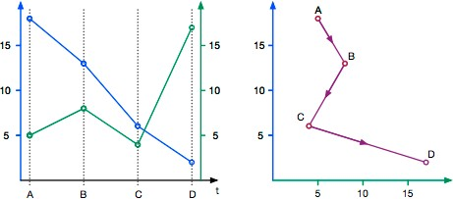
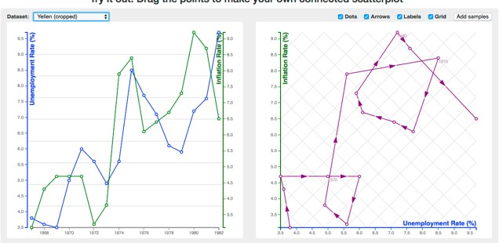
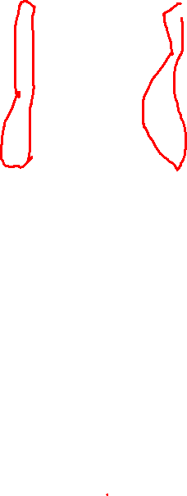
Idiom: connected scatterplots
scatterplot with line connection marks
popular in journalism
horiz + vert axes: value attribs
line connection marks: temporal order
alternative to dual-axis charts
horiz: time
vert: two value attribs
empirical study
engaging, but correlation unclear
[The Connected Scatterplot for Presenting Paired Time Series. Haroz, Kosara and Franconeri. IEEETVCG 22(9):2174-86, 2016.]
http://steveharoz.com/research/connected_scatterplot/
21

Slide 19
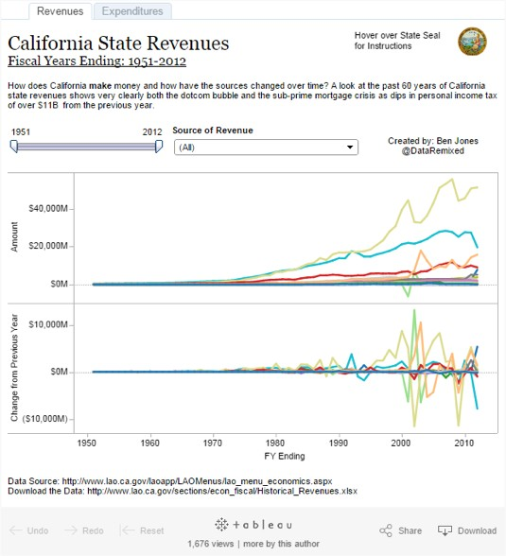
Idiom: Indexed line charts
data: 2 quant attires
1 key + 1 value
derived data: new quant value attrib
index
plot instead of original value
task: show change over time
principle: normalized, not absolute
scalability
same as standard line chart
https://public.tableau.com/profile/ben.jones#!/vizhome/CAStateRevenues/Revenues
22

Slide 20
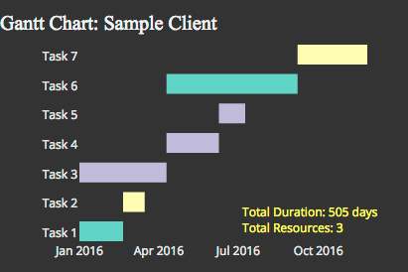
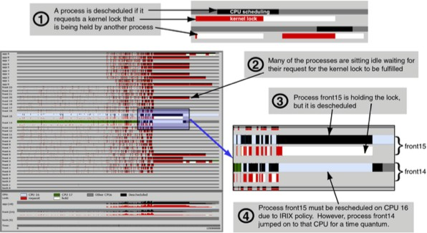
Idiom: Gantt charts
one key, two (related) values
data
1 categ attrib, 2 quant attribs
mark: line
length: duration
channels
horiz position: start /end times
horiz length: duration
task
emphasize temporal overlaps, start/end dependencies between items
scalability
dozens of key levels
hundreds of value levels
https://www.r-bloggers.com/gantt-charts-in-r-using-plotly/
[Performance Analysis and Visualization of Parallel Systems Using SimOS and Rivet: A Case Study. Bosch, Stolte, Stoll, Rosenblum, and Hanrahan. Proc. HPCA 2000.]
23

Slide 21


Idiom: heatmap
two keys, one value
– data
2 categ attribs (gene, experimental condition)
1 quant attrib (expression levels)
– marks: area
separate and align in 2D matrix
– indexed by 2 categorical attributes
– channels
color by quant attrib
– (ordered diverging colormap)
– task
find clusters, outliers
– scalability
Many Keys
Recursive Subdivision
1 Key
List
2 Keys
Matrix
1M items, 100s of categ levels, ~10 quant attrib levels
24

Slide 22
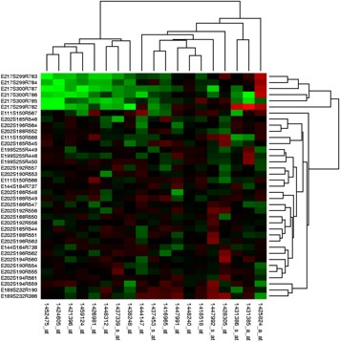
Idiom: cluster heatmap
in addition
– derived data
2 cluster hierarchies
– dendrogram
parent-child relationships in tree with connection line marks
leaves aligned so interior branch heights easy to compare
– heatmap
marks (re-)ordered by cluster hierarchy traversal

Slide 23
Axis Orientation
Rectilinear
Parallel
Radial

Slide 24


Idioms: scatterplot matrix, parallel coordinates
scatterplot matrix (SPLOM)
– rectilinear axes, point mark
– all possible pairs of axes
– scalability
one dozen attribs
dozens to hundreds of items
parallel coordinates
Scatterplot Matrix Parallel Coordinates
Math Physics Dance Drama
100
90
80
70
60
50
40
30
20
10
0
Math
Physics
Dance
Drama
Math
Physics
Dance
Drama
– parallel axes, jagged line representing item
– rectilinear axes, item as point
axis ordering is major challenge
– scalability
dozens of attribs
Table
Math Physics Dance Drama 85 95 70 65
90 80 60 50
65 50 90 90
50 40 95 80
40 60 80 90
hundreds of items
after [Visualization Course Figures. McGuffin, 2014. http://www.michaelmcguffin.com/courses/vis/]
27

Slide 25
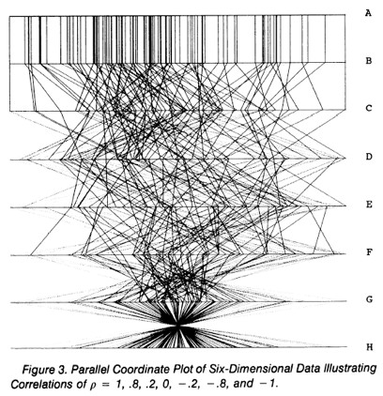
Task: Correlation
scatterplot matrix
– positive correlation
diagonal low-to-high
– negative correlation
diagonal high-to-low
– uncorrelated
parallel coordinates
– positive correlation
parallel line segments
– negative correlation
[A layered grammar of graphics.Wickham. Journ. Computational and Graphical Statistics 19:1 (2010), 3–28.]
all segments cross at halfway point
– uncorrelated
scattered crossings
[Hyperdimensional Data Analysis Using Parallel Coordinates. Wegman. Journ. American Statistical Association 85:411 (1990), 664–675.]
2
8

